Slide 1
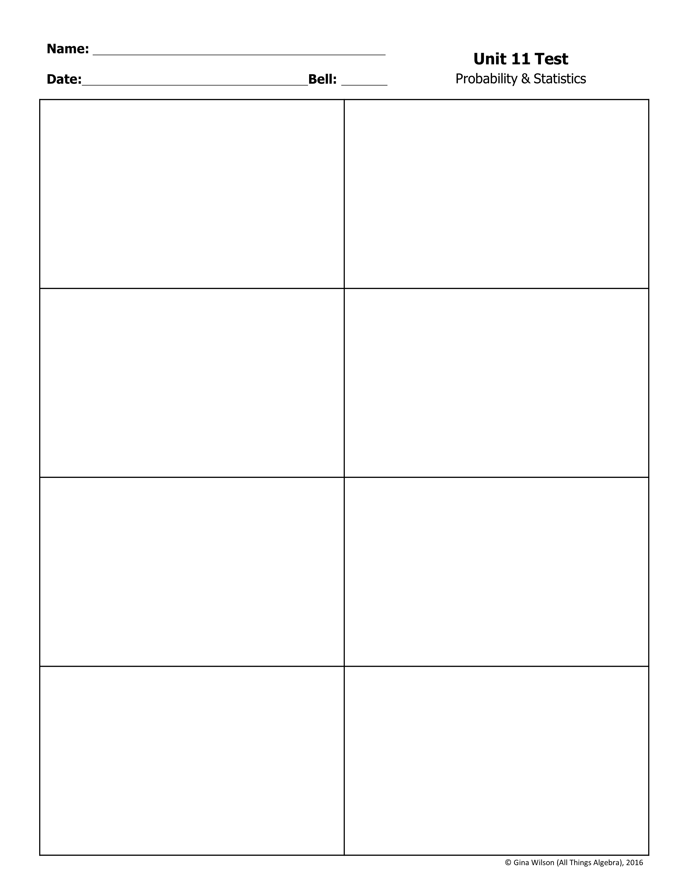
1. The library labels each book with a five-digit code to identify the book in their computer system. Each code is 3 digits (0-9) followed by two letters. How many codes are possible?
2. A test has 30 multiple choice questions with 4 choices each. Which expressions represents the total number of ways to answer the questions?
A. 468 B. 492,804 C. 527,000 D. 676,000
A. B. C. D.
3. A coach needs to choose two players from the hockey team to be captain and assistant captain. If there are 20 players on the team, how many ways he can assign the two roles?
4. In a card game, each player is dealt a hand of 7 cards from a deck of 52 playing cards. Which expression represents the number of hands possible?
A. 100 B. 190 C. 380 D. 450
A. C. B. D.
5. SweetTooth Frozen Yogurt has 12 different toppings to choose from. If they add two new toppings, how many ways more ways can Ian choose three?
6. How many different ways can the 11 letters in the word PROBABILITY be arranged?
A. 220 B. 144 C. 364 D. 864
A. 1,663,200 B. 7,241,600 C. 9,979,200 D. 39,916,800
7. A month of the year is selected at random. What is the probability that it has 31 days or starts with the letter J?
8. A card is selected at random from a standard deck of 52 playing cards. What is the probability that it is not a face card?
A. C. B. D.
A. C. B. D.

Slide 2
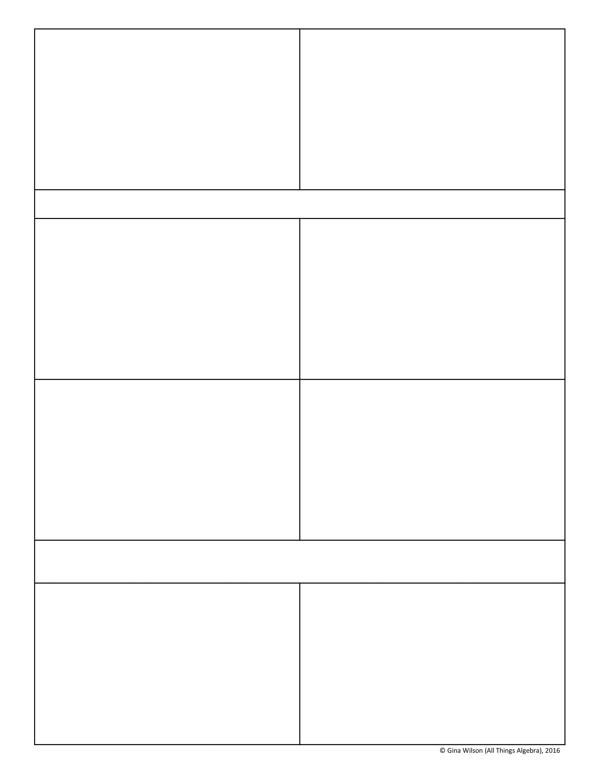
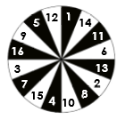
9. A die is rolled then a letter in the word STATISTICS is randomly selected. What is the probability of at least a three, then the letter S?
10. Gavin and Jack are practicing shots against their goalie. On their last 15 attempts, Gavin made 6 and Jack made 7. Based on this performance, what is the probability that they both make their next shot?
A. C. B. D.
A. C. B. D.
Use for questions 11-12: A basket contains 8 green apples, 11 red apples, 5 nectarines, and 12 oranges. Mark randomly chooses a piece of fruit, eats it, then selects another. Find each probability.
11. P(a green apple then a nectarine)
12. P(two oranges)
A. C. B. D.
A. C. B. D.
13. The spinner below is spun. Find the probability that it lands on a an odd number, given that it lands on a white space. Write your answer as a fraction in simplest form.
14. Two dice are rolled. What is the probability that the sum of the dice is at least 5, given that one die is showing a 2.
A. C. B. D.
Use for questions 15-16. Out of a group of 120 students that were surveyed about winter sports, 28 said they ski and 52 said they snowboard. Sixteen of the students who said they ski said they also snowboard. If a student is chosen at random, find each probability.
15. P(snowboard | ski)
16. P(ski | does not snowboard)
A. C. B. D.
A. C. B. D.

Slide 3
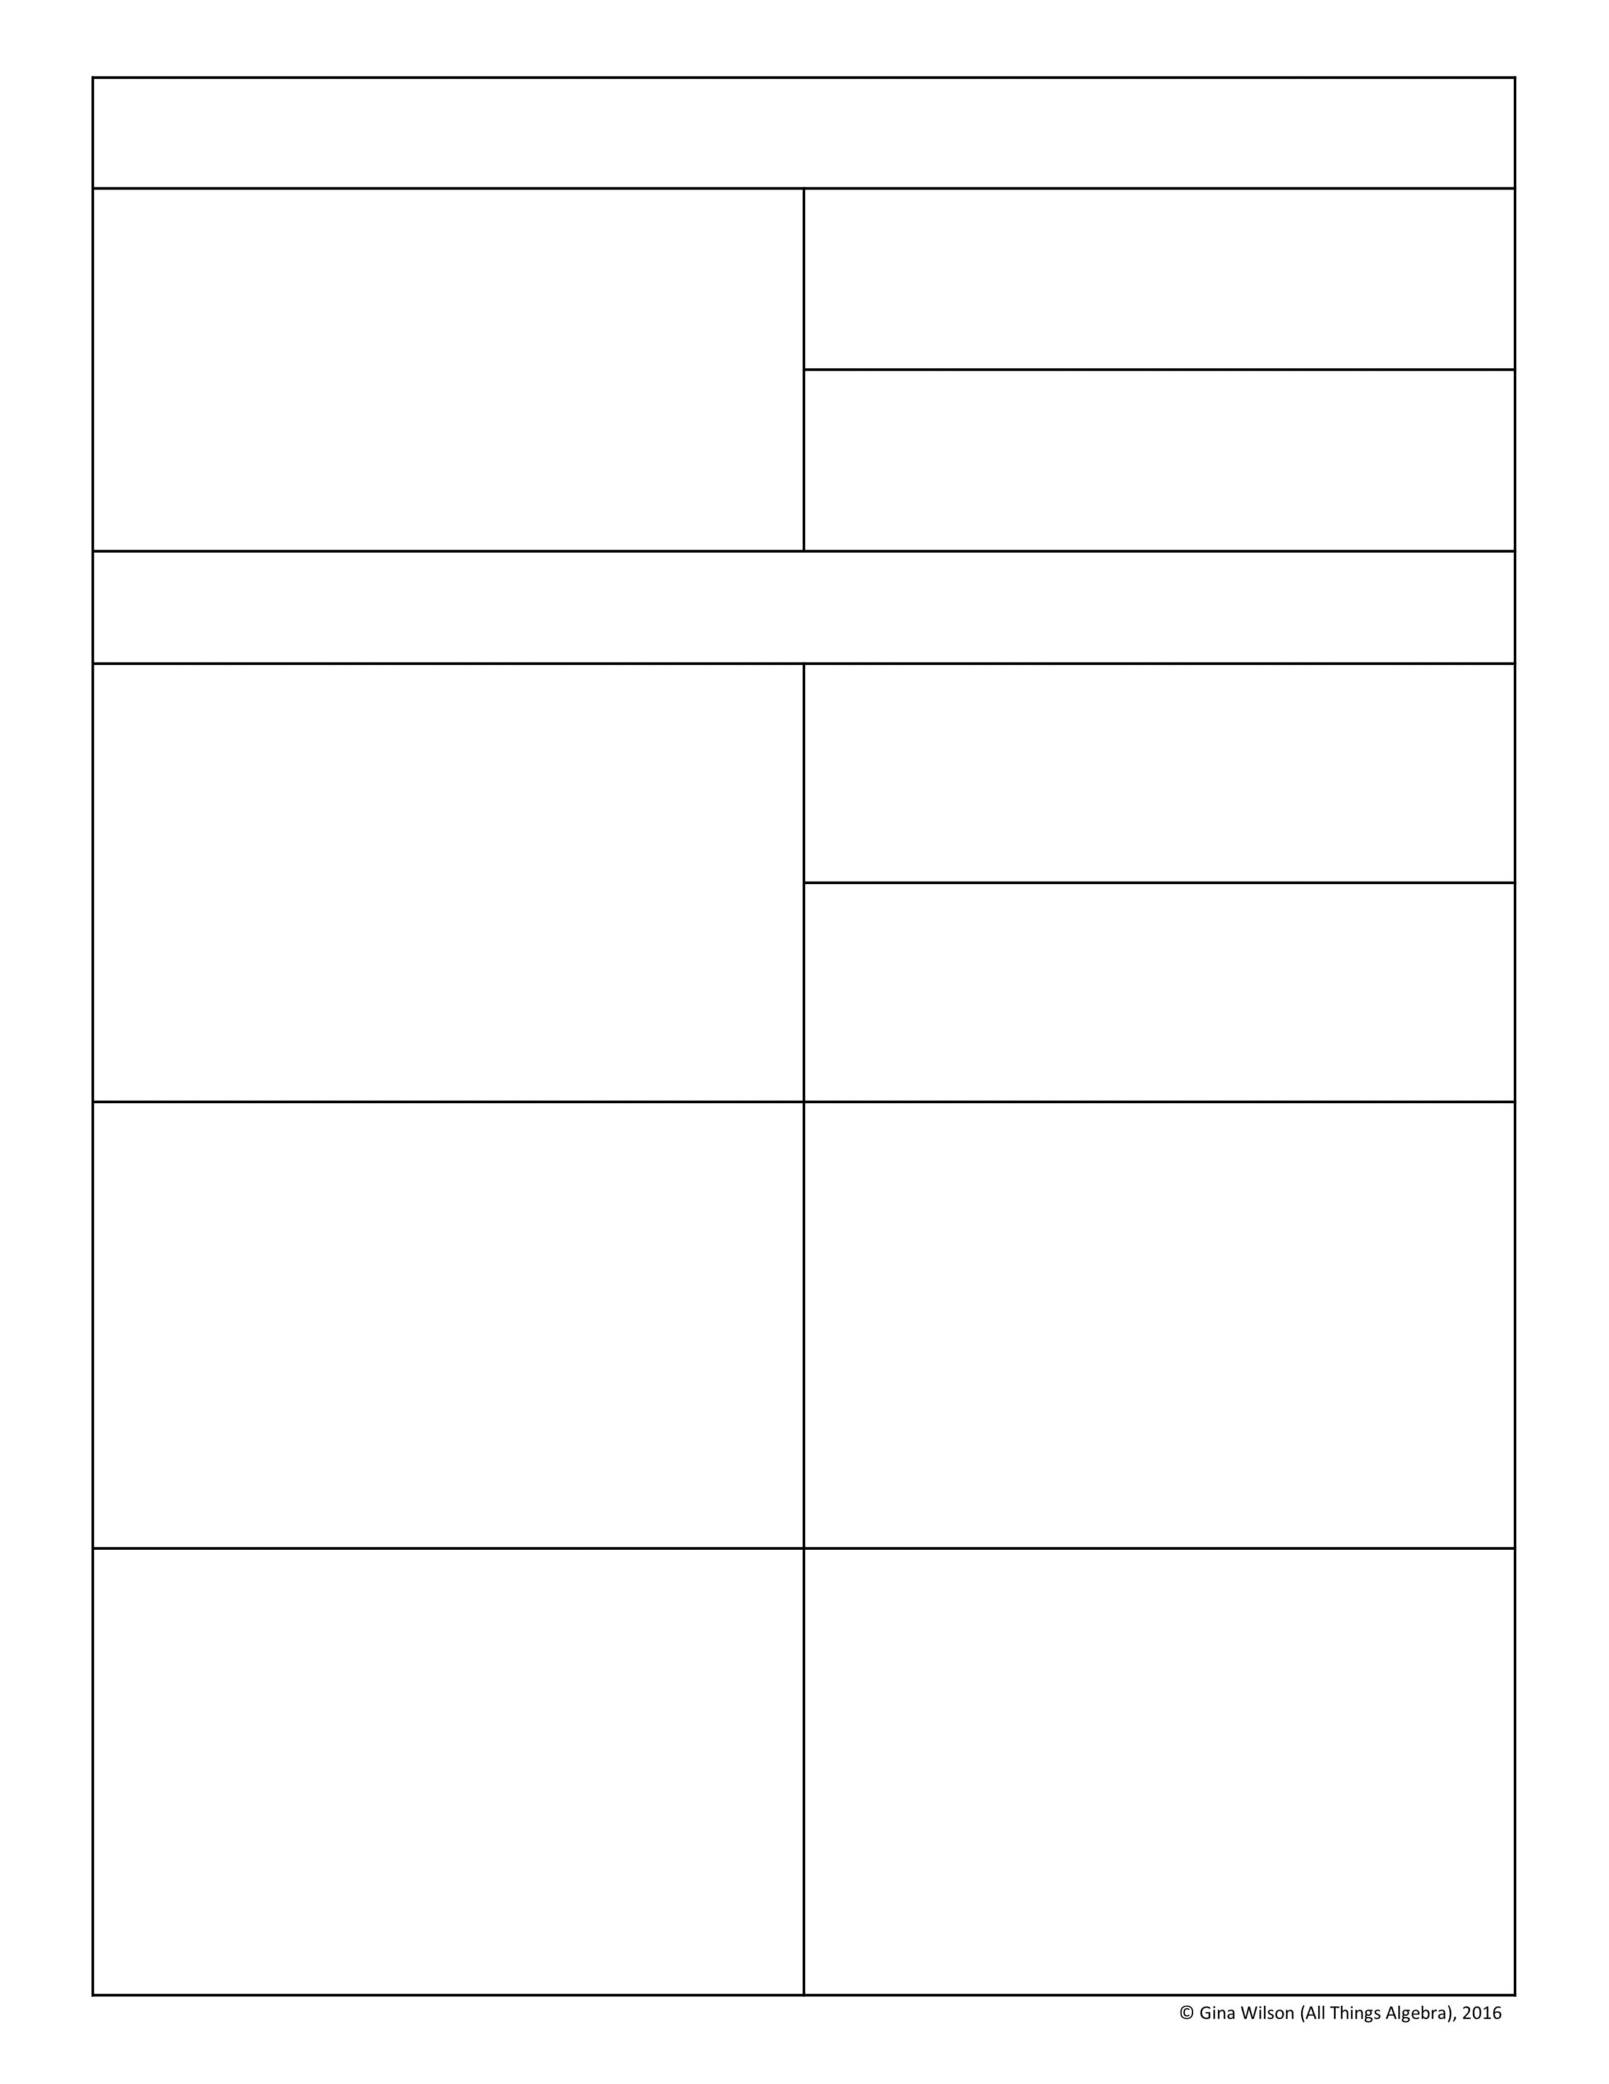
Use for questions 17-18. The table below shows the number of students at Parkland High School that made honor roll last quarter. If a student is chosen at random, find each probability. Give your answers as fractions in simplest form.
 | Honor Roll
 | Yes | No
9th Grade | 72 | 120
10th Grade | 95 | 117
11th Grade | 76 | 124
12th Grade | 57 | 139
17. P(honor roll | 11th grader)
18. P(9th grader | not honor roll)
Use for questions 19-20. Rob and Casey are at batting practice. The table below shows the joint relative frequencies for their misses, fouls, hits, and homeruns. Give the marginal relative frequencies, then find each probability.
19. P(homerun | Casey)
 | Rob | Casey | Total
Misses | .05 | .1125
Fouls | .10 | .05
Hits | .2875 | .3375
Homeruns | .0375 | .025
Total
A. B. C. D.
20. P(Rob | hit)
A. B. C. D.
21. The odds of winning a game at the carnival are 3 in 7. If Liza plays the game nine times, what is the probability that she wins exactly two times?
22. When Sophia’s mom picks her up from school, she is late one third of the time. For the next 15 days, what is the probability that she will be late at most three days?
A. 13.15% B. 3.12% C. 10.84% D. 8.23%
A. 79.08% B. 79.31% C. 20.69% D. 20.92%
23. When Tom plays darts, he hits the target 65% of the time. Find the probability that he hits the target at least four out of next six attempts.
24. What is the fourth term in the binomial expansion of (2x – y)⁷?
A. 57.17% B. 64.71% C. 42.83% D. 35.29%
A. B. C. D.

Slide 4
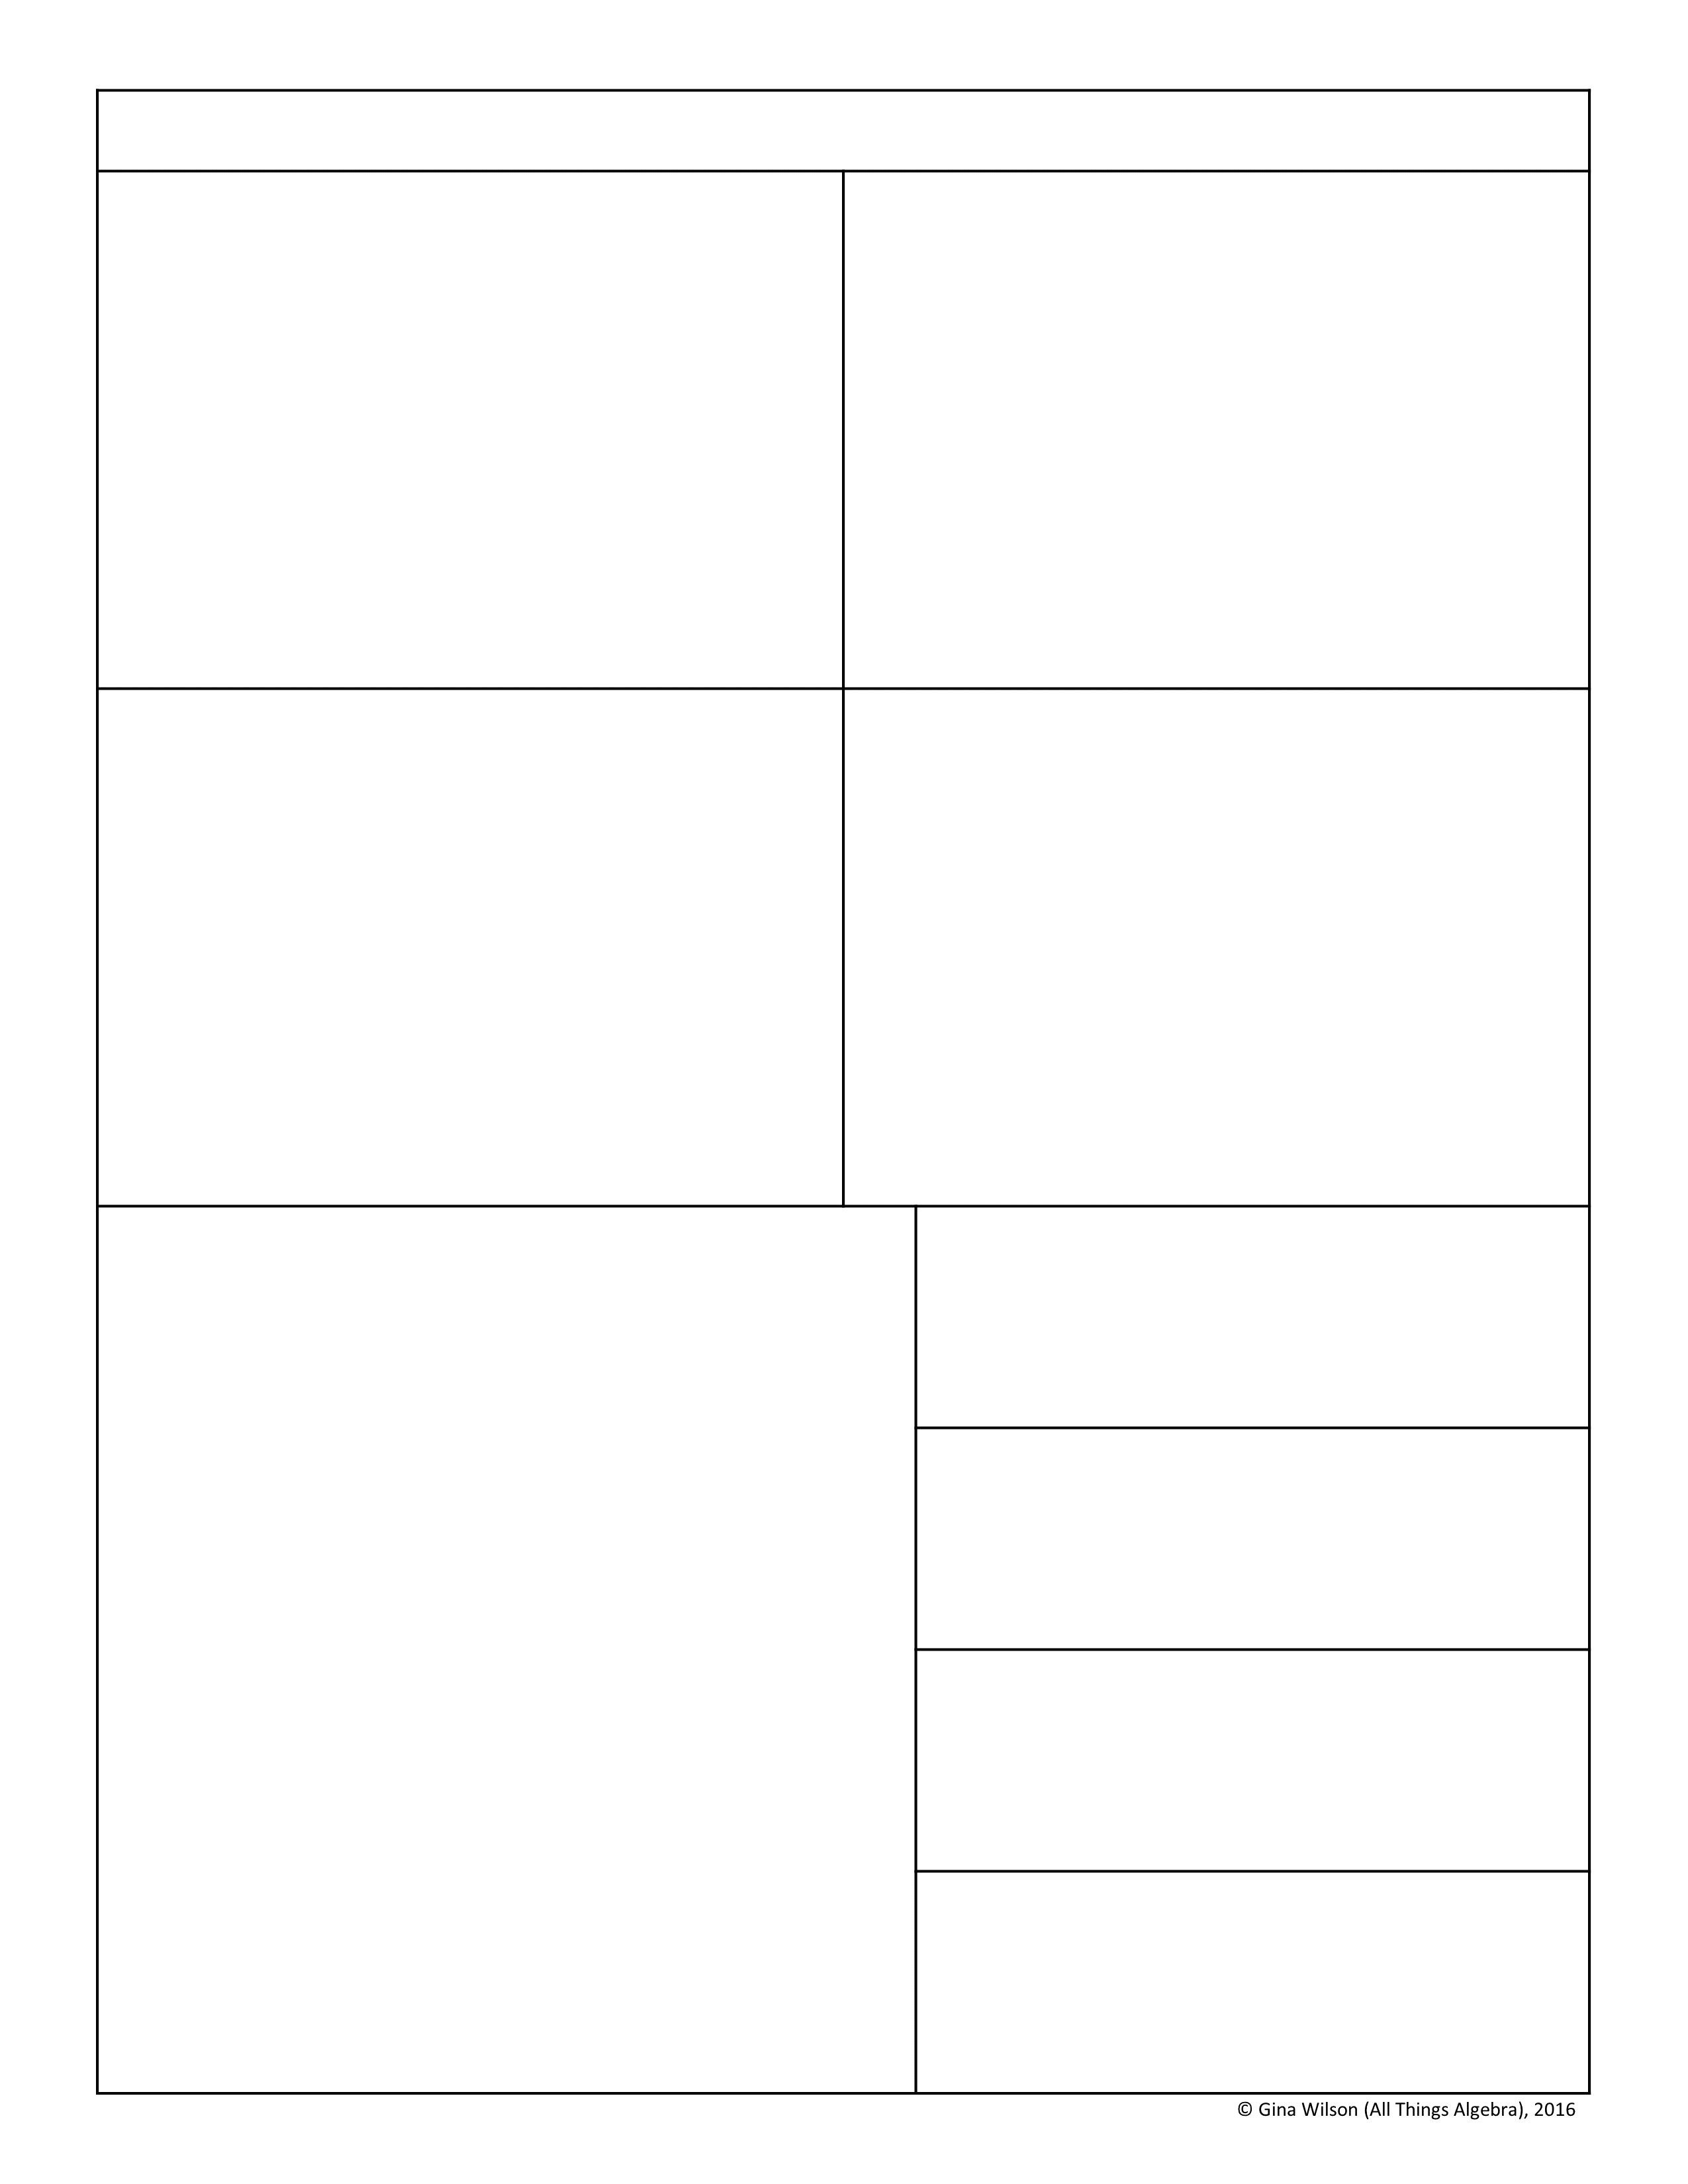
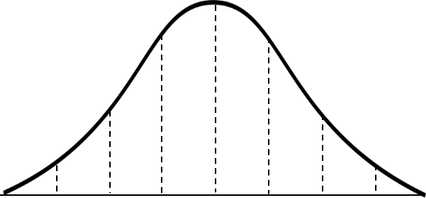
Use for questions 25-26: The following data represents the high temperatures for the next several days in Buffalo, NY: {17, 26, 3, 13, 29, 34, 32, 30, 41}
25. Find the mean absolute deviation. Round your answer to the nearest hundredth of a degree.
26. Which of the following values represent the standard deviation and variance for the data?
A. Standard Deviation = 9.33; Variance = 3.05 B. Standard Deviation = 9.33; Variance = 87.05 C. Standard Deviation = 11.16; Variance = 124.55 D. Standard Deviation = 11.16; Variance = 3.34
27. Given Data Set A: {12, 14, 17, 5, 10, 8}
28. If the mean and standard deviation of a data set are given, which data set has a variance equal to 16?
If 6 is added to this data set, which statement accurate describes the change in the disbursement of data.
A. Mean = 4; Standard Deviation = 8 B. Mean = 256; Standard Deviation = 8 C. Mean = 4; Standard Deviation = 256 D. Mean = 256; Standard Deviation = 4
A. It will decrease. B. It will increase. C. It will stay the same. D. It’s impossible to tell.
The wind speeds throughout the month of April were normally distributed with a mean of 17 mph and a standard deviation of 4 mph. Label the normal distribution curve, then answer questions 29-32:
29. What percent of the days had wind speeds between 5 and 13 mph?
30. What percent of the days had wind speeds of at least 9 mph?
31. What is the probability that a day had a wind speed of no more than 21 mph?
32. Approximately how many days had wind speeds between 17 and 25 mph?

Slide 5
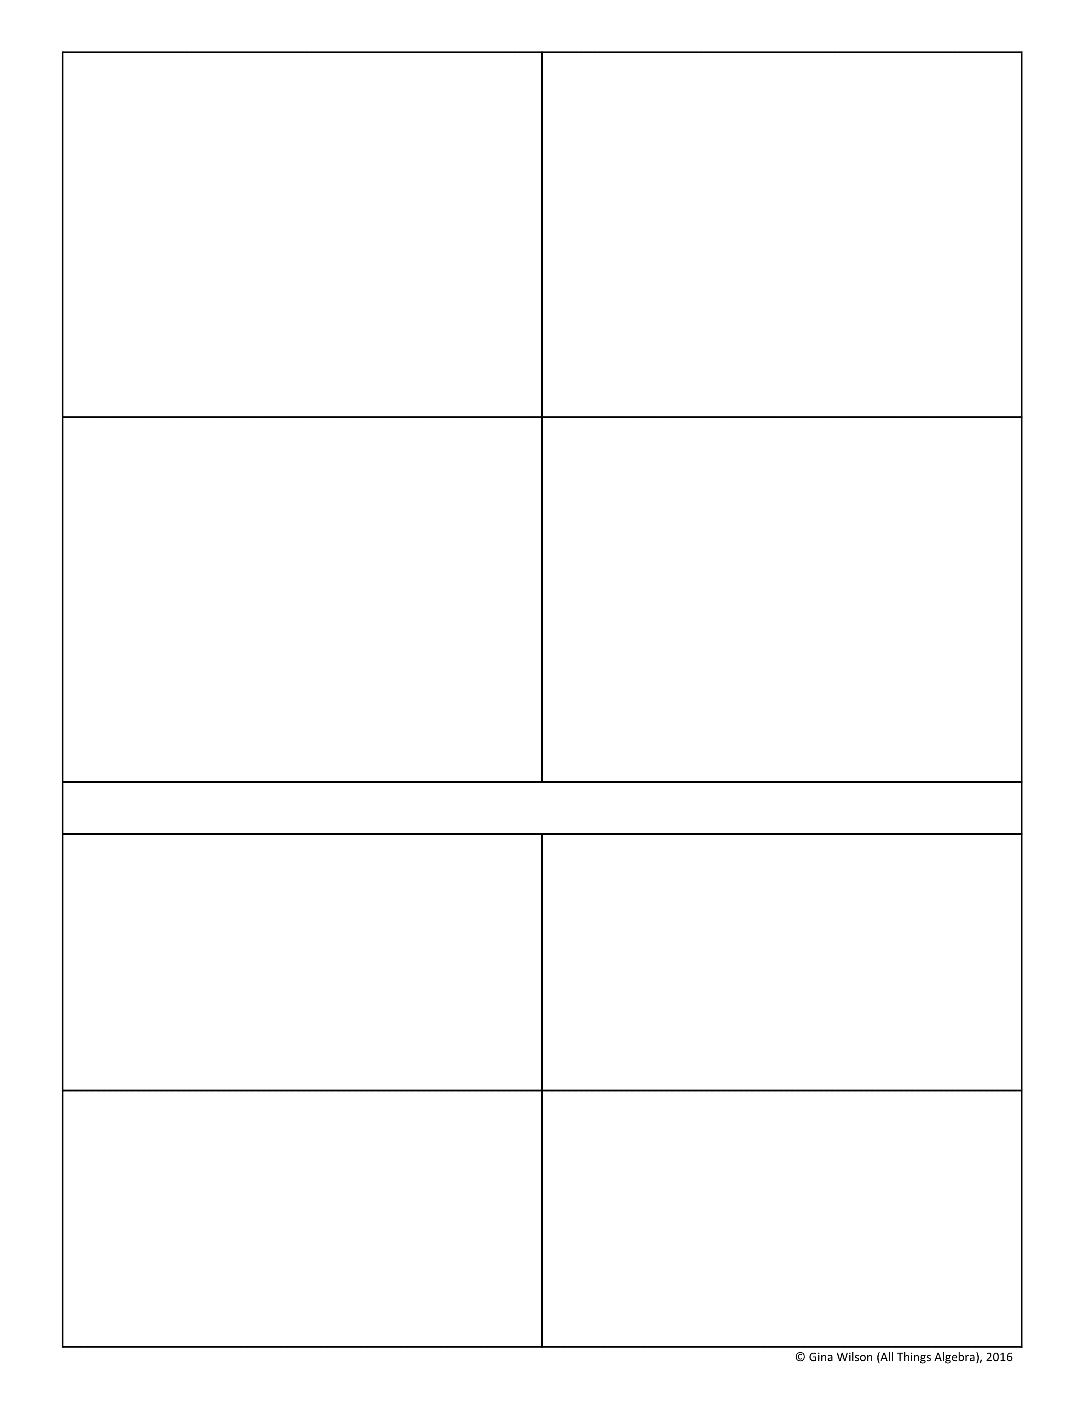
34. The time it takes to complete a test is normally distributed with a mean of 45 minutes and a standard deviation of 12 minutes. If Nick took an hour and 8 minutes to complete the test, find his z-score to the nearest hundredth.
35. The mean price of a computers sold at a particular store is $949 with a standard deviation of $75. The z-score of a certain computer is -0.8. What is the price of the computer?
35. The number of ounces of water a person drinks per day is normally distributed with a standard deviation of 15 ounces. If Sean drinks 88 ounces per day with a z-score of 1.6, what is the mean ounces a day of water that a person drinks?
36. The scores on an Algebra 2 midterm were normally distributed with a mean of 82. If Kendall scored 67 with a z-score of -2.5, what is the standard deviation?
Use for questions 37-40: The 100-meter dash times in the girls track meet were normally distributed with a mean of 13 seconds and a standard deviation of 0.3 seconds.
37. What is the probability that a runner finished between 12.4 and 14 seconds?
38. What is the probability that a runner finished in under 12.7 seconds?
39. What is the probability that it took a runner more than 13.5 seconds?
40. Lana finished the race in 13.2 seconds. If 84 other girls ran in the event, approximately how many runners did she beat?

